Slide 1
Fahsai
• Thai Restaurant •
Dhitiwat Jongsuebchoke 58090010
Virayut Sandhu 58090035
Atichat Lappanopakon 58090043

Slide 2



Order
Counter
Manager

Slide 3
1
Tablet Order

Slide 4

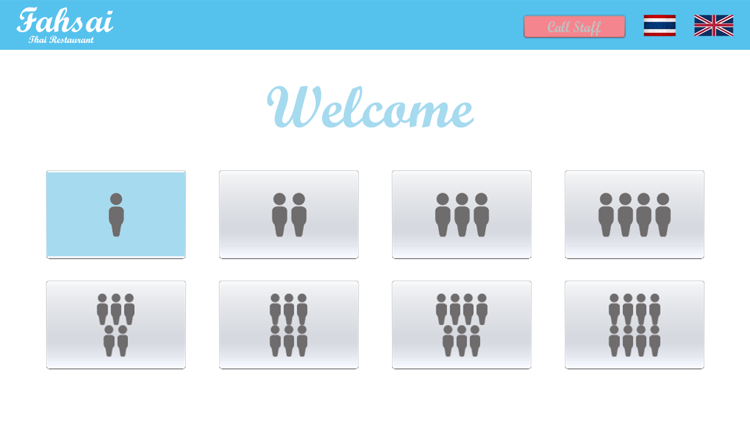

Slide 5
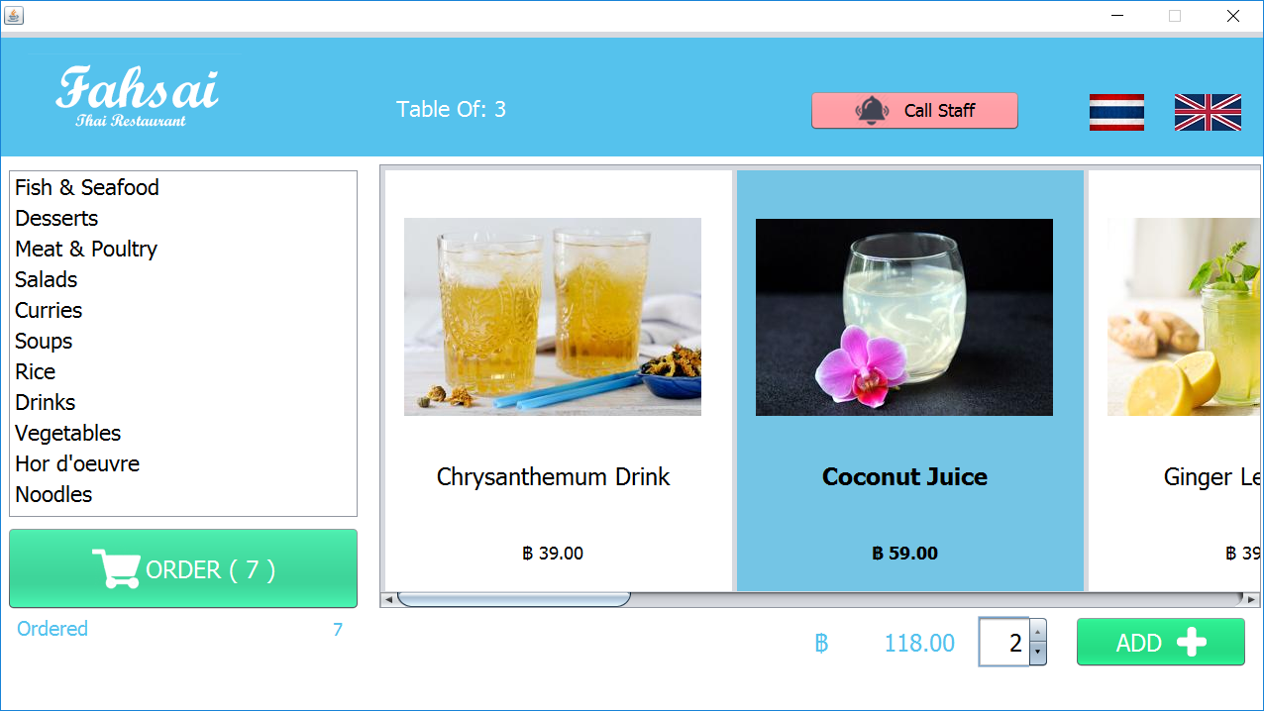

Slide 6
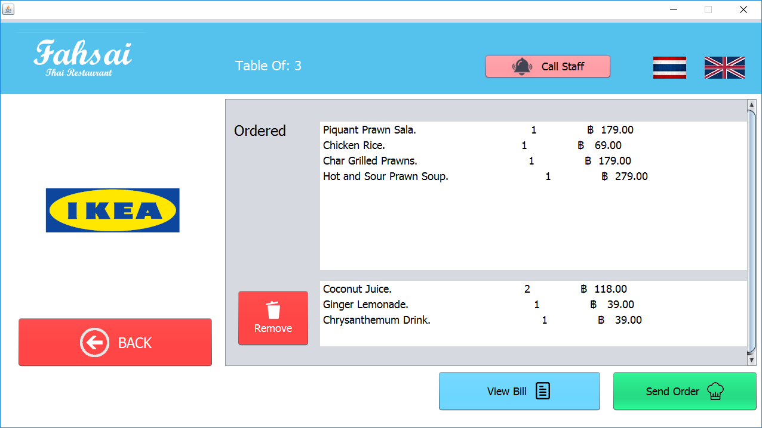

Slide 7
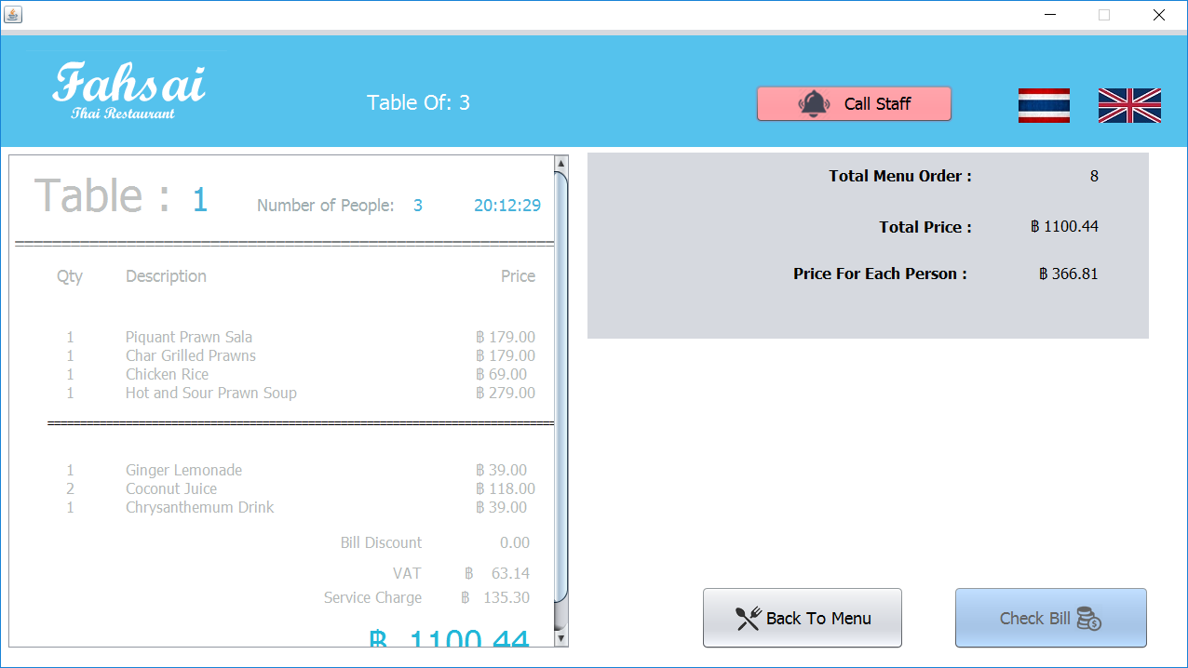

Slide 8
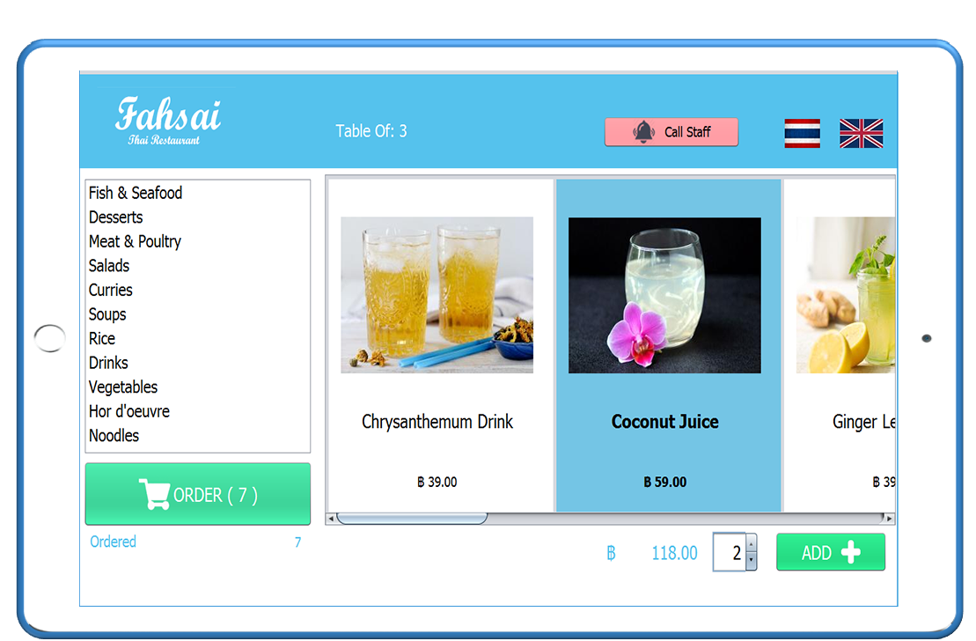
Tablet Order
Convenient
Efficient
Elegance

Slide 9
2
Cashier Management

Slide 10
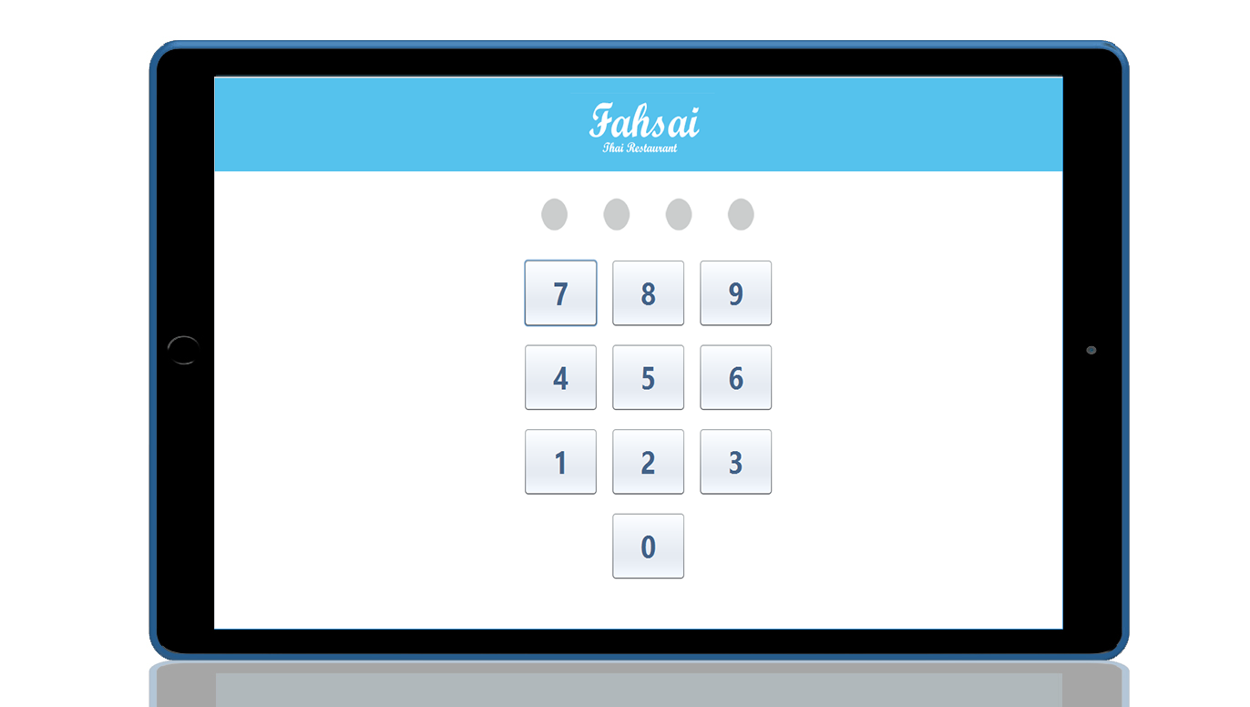
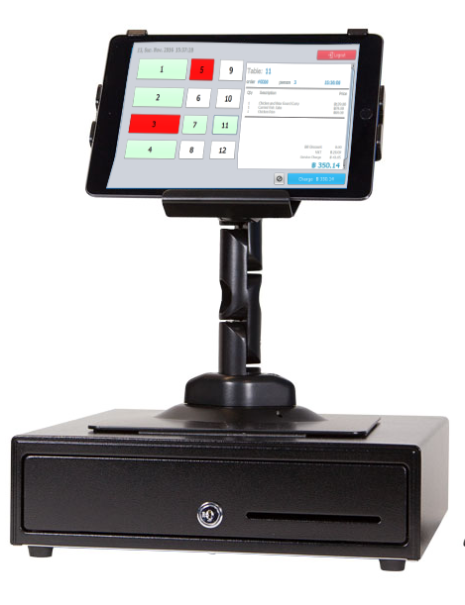

Slide 12

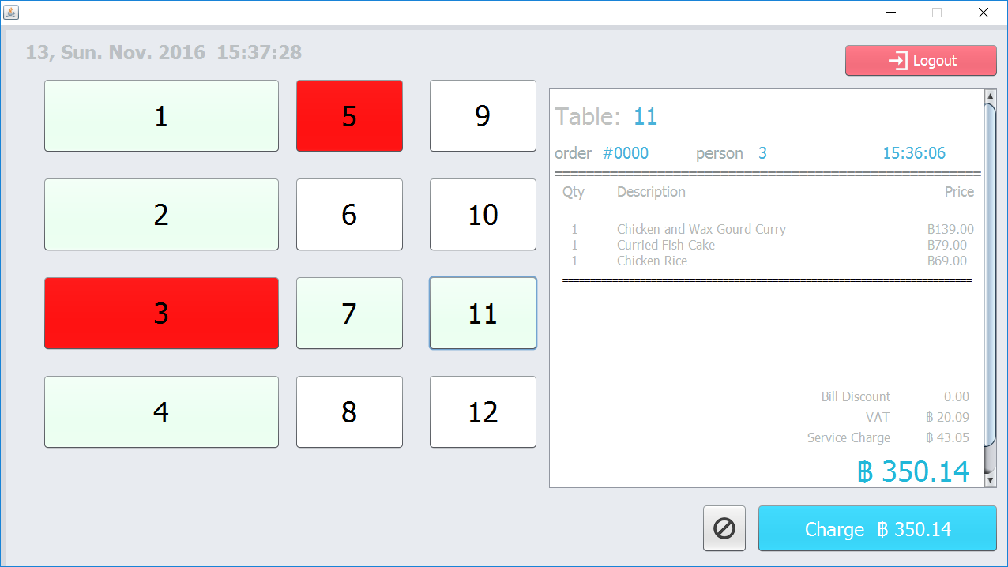

Slide 13
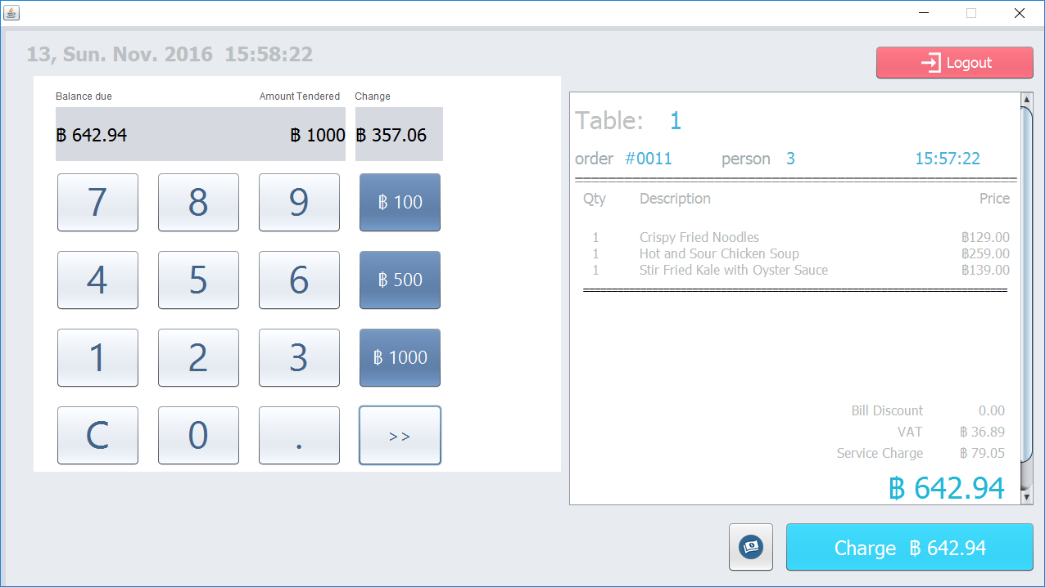

Slide 14
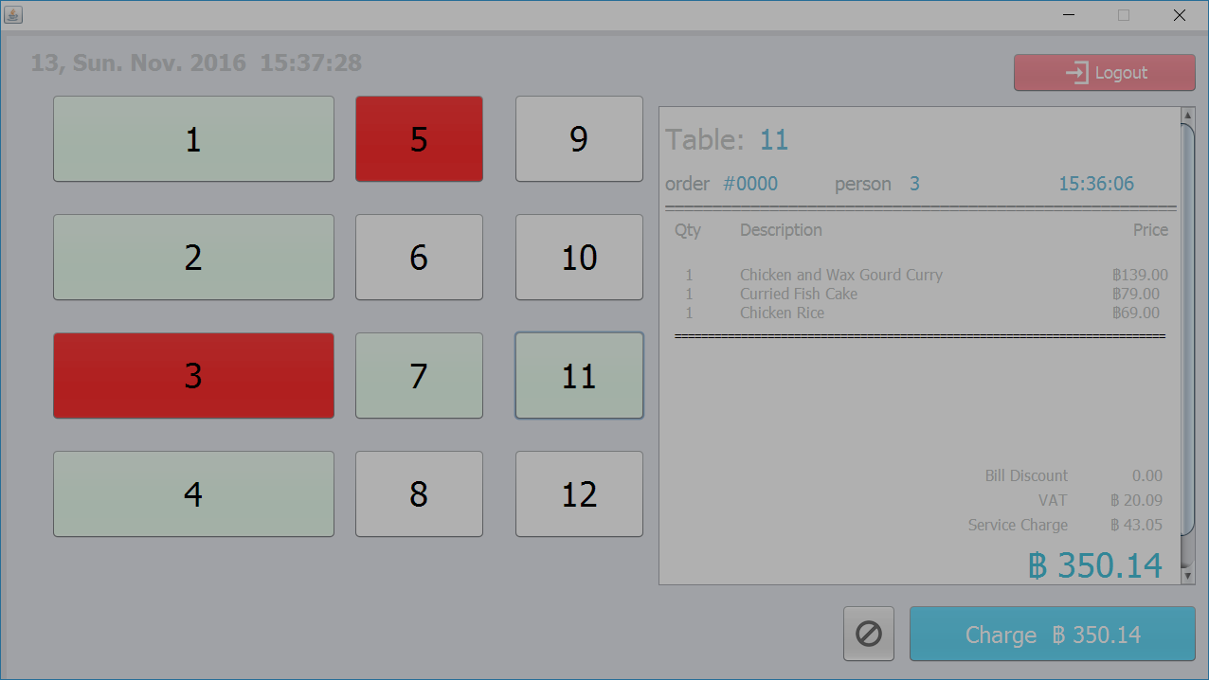
One more things…

Slide 15
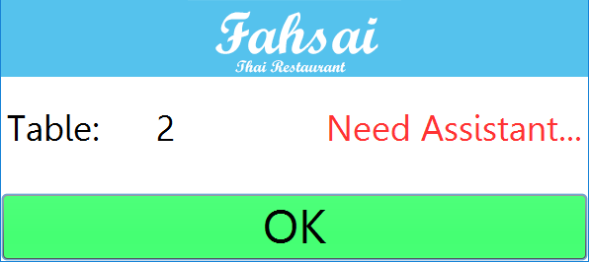

Slide 16
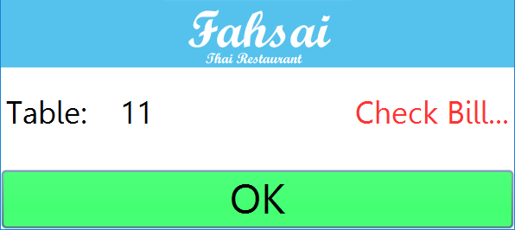

Slide 17
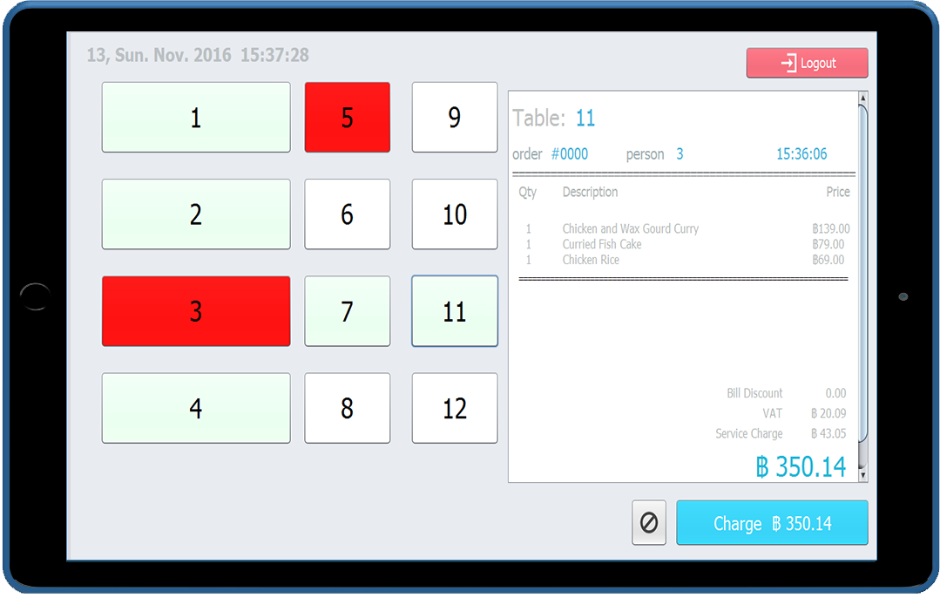
Cashier Management
Easy
Simple
Fast

Slide 18
3
Manager Management

Slide 19

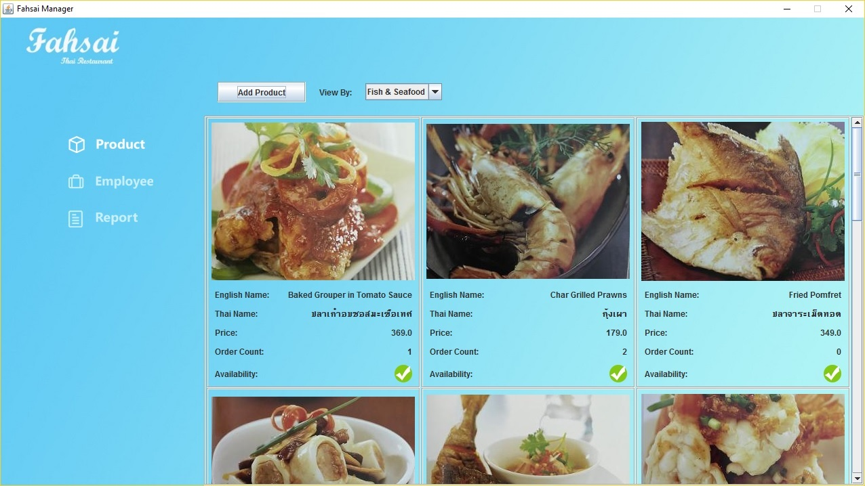

Slide 20
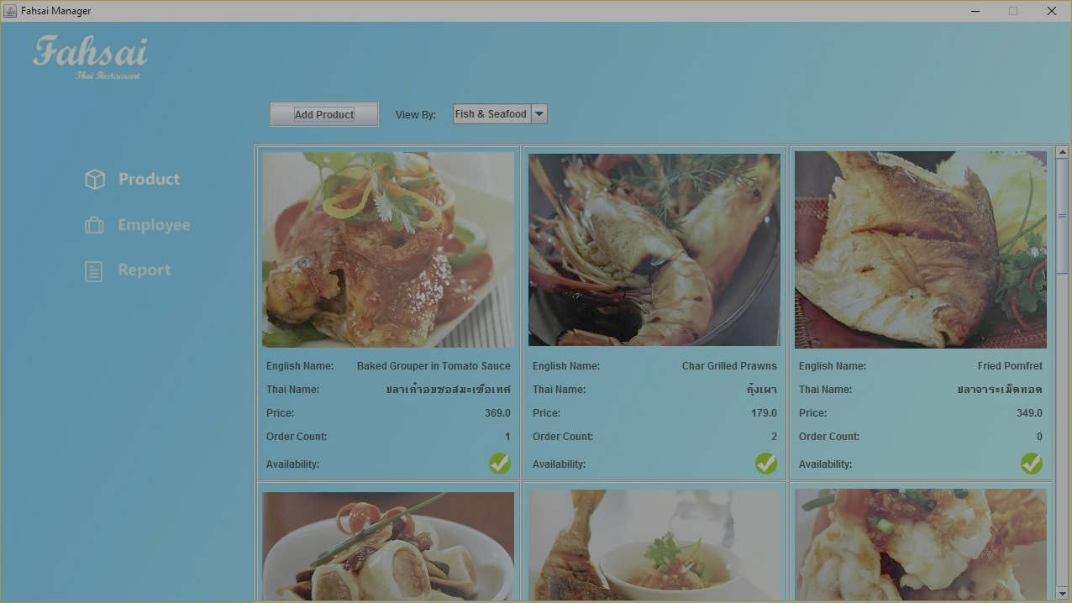
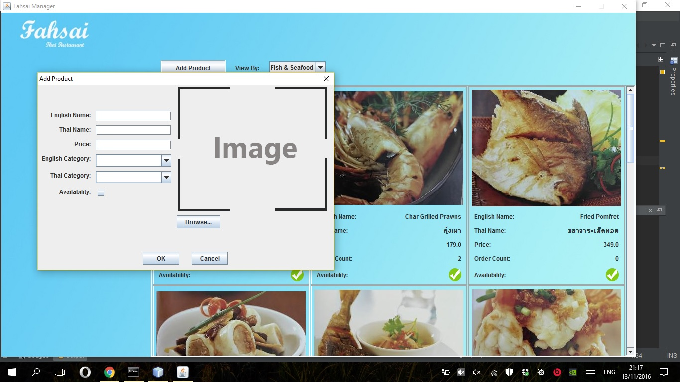
Add Product

Slide 21
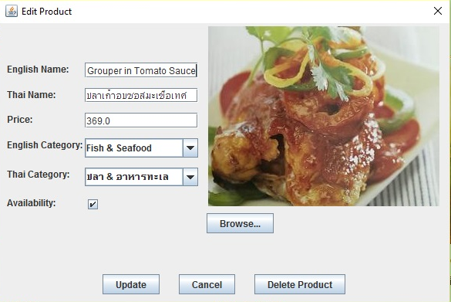
Edit Product

Slide 22
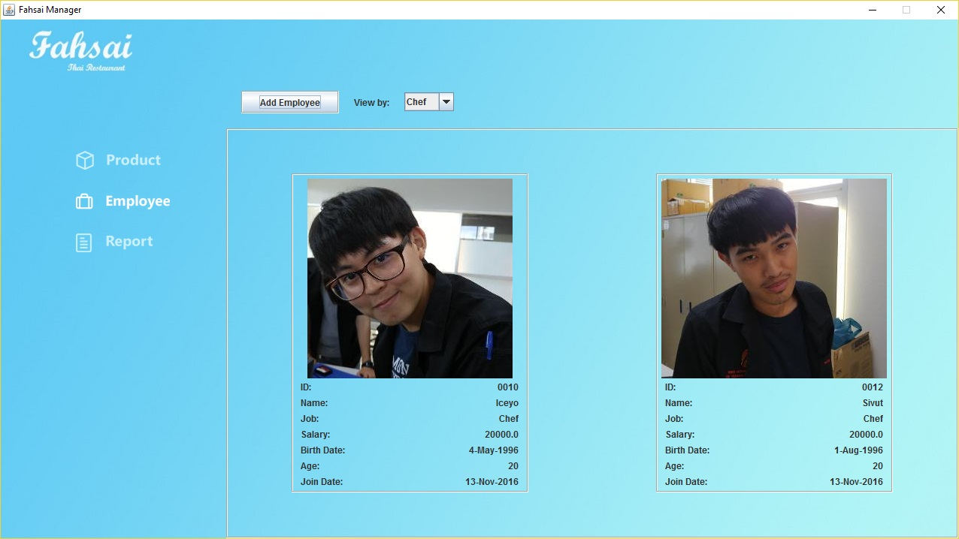

Slide 23
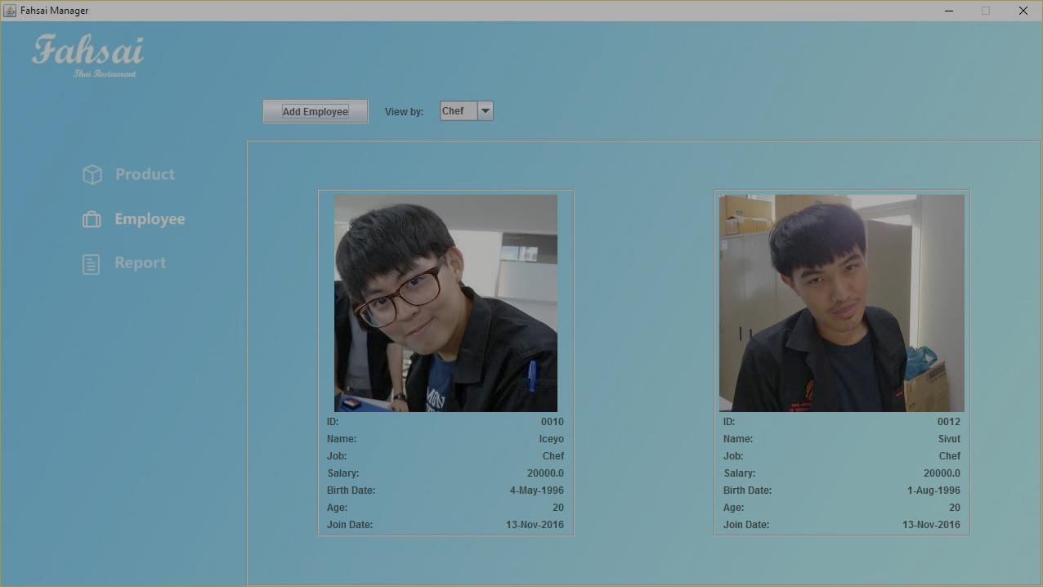
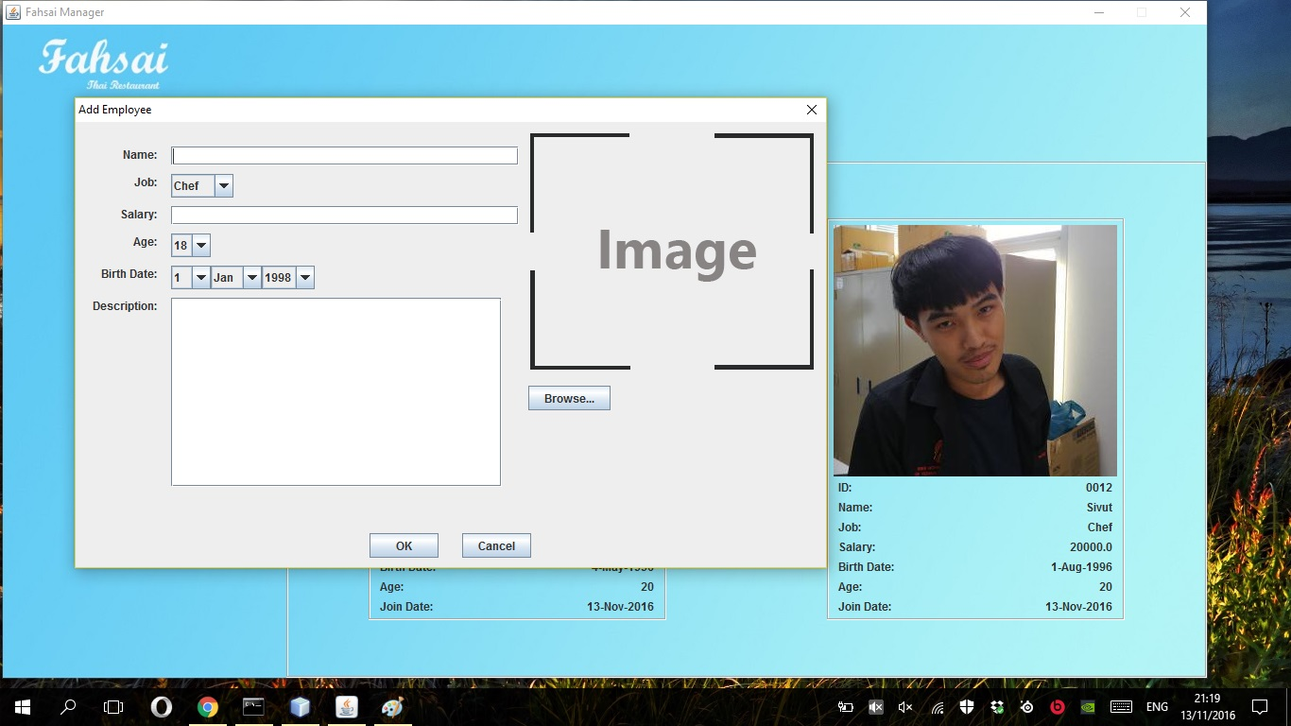
Add Employee

Slide 24
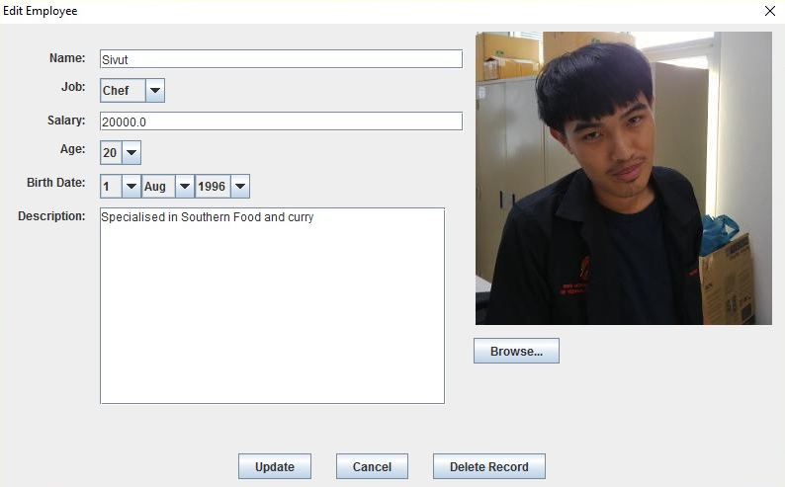
Edit Employee

Slide 25
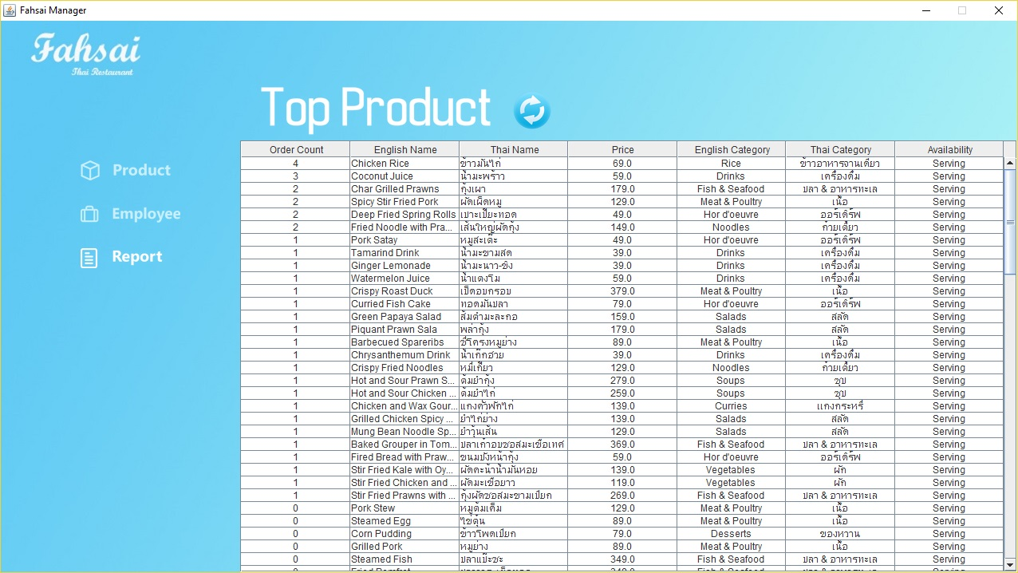

Slide 26
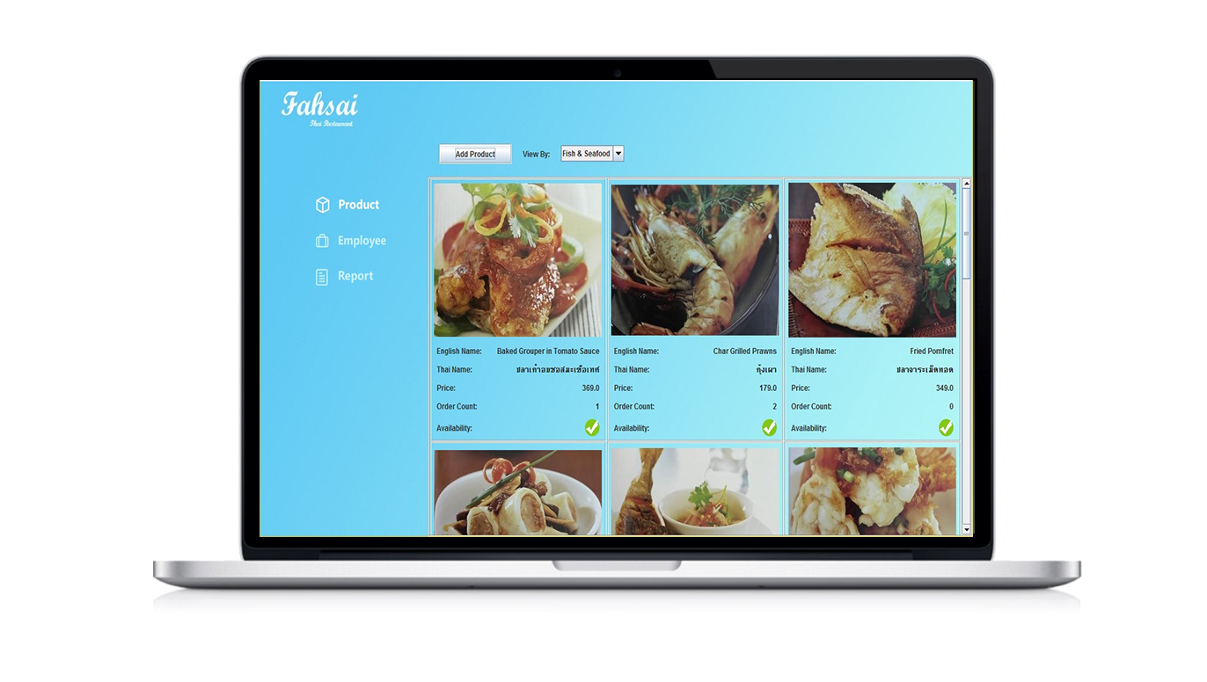
Manager Management
Full
Efficient
User-Friendly

Slide 27
Order
Counter
Manager

Slide 28
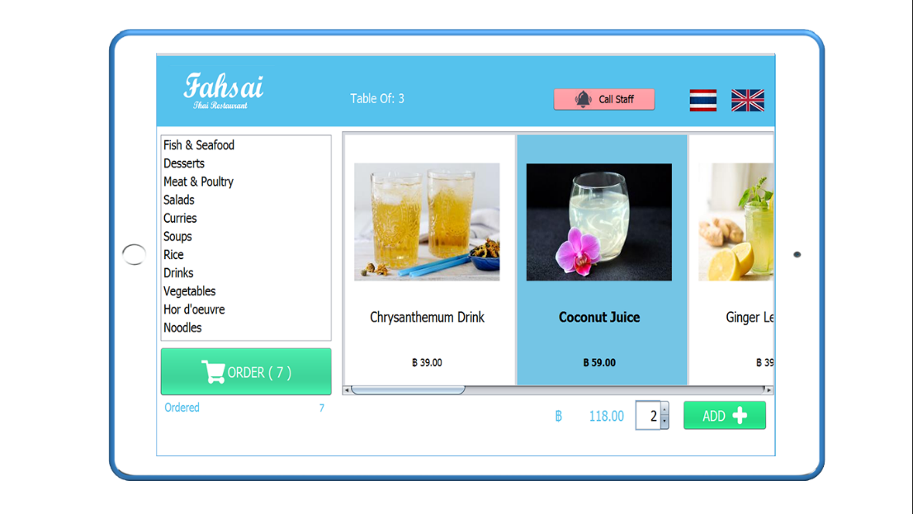
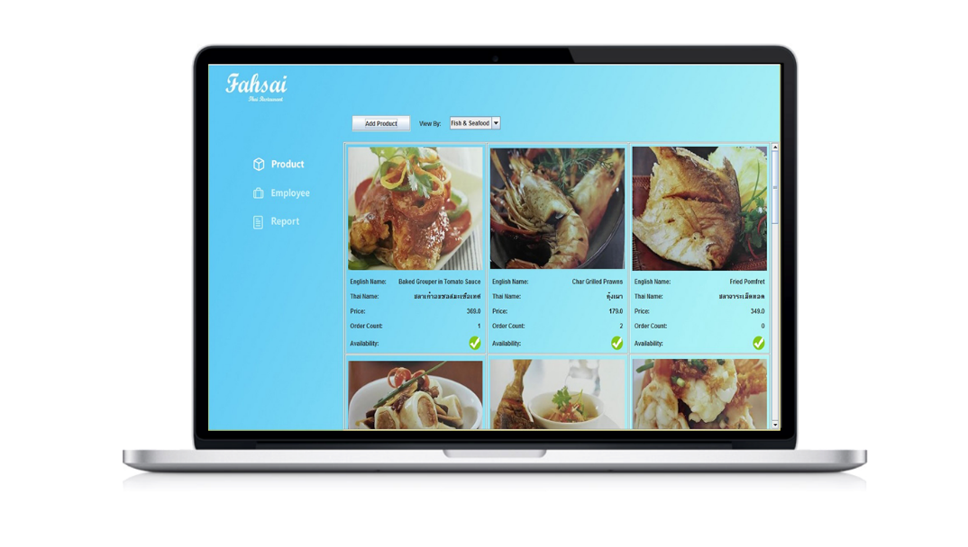
Order
Manager
Counter

Slide 29
DEMO

Slide 30
Fahsai
• Thai Restaurant •

Slide 31

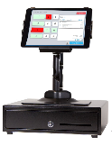
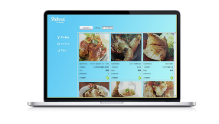
Fast
Simple
Easy
Efficient
Fahsai
Convenient
• Thai Restaurant •
Full
Elegance
User - Friendly

Slide 32
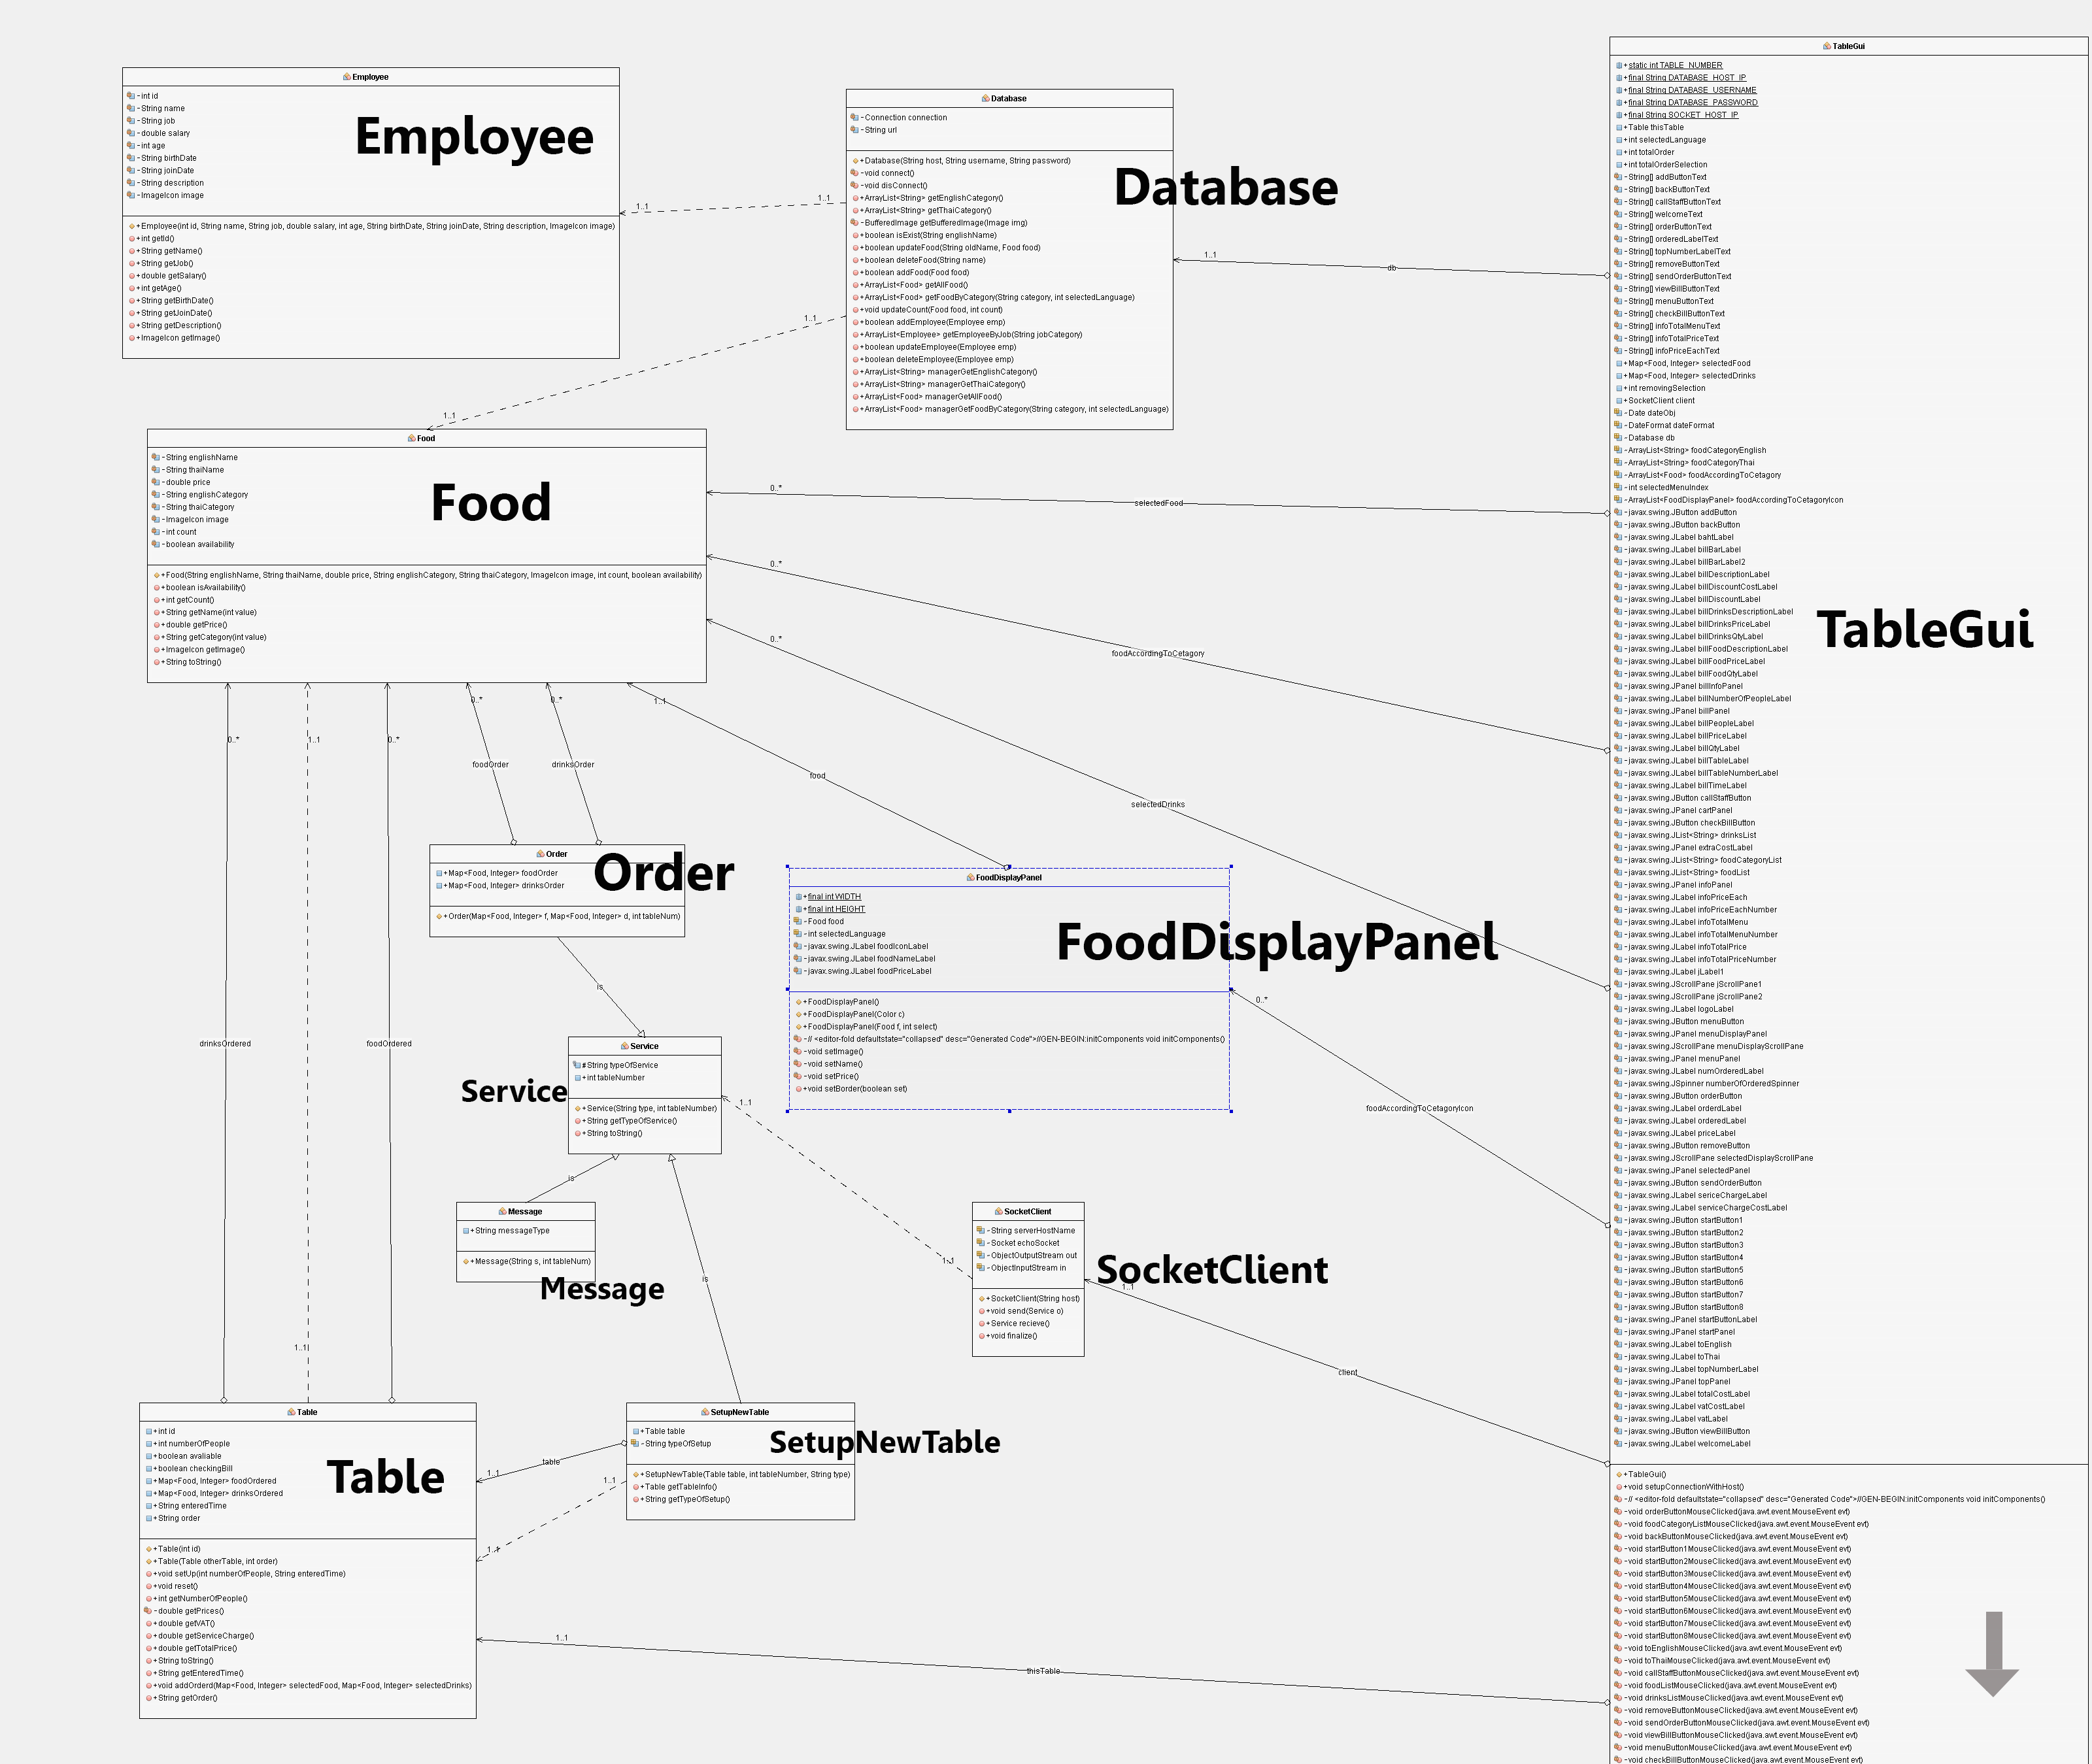
Table Diagram

Slide 33
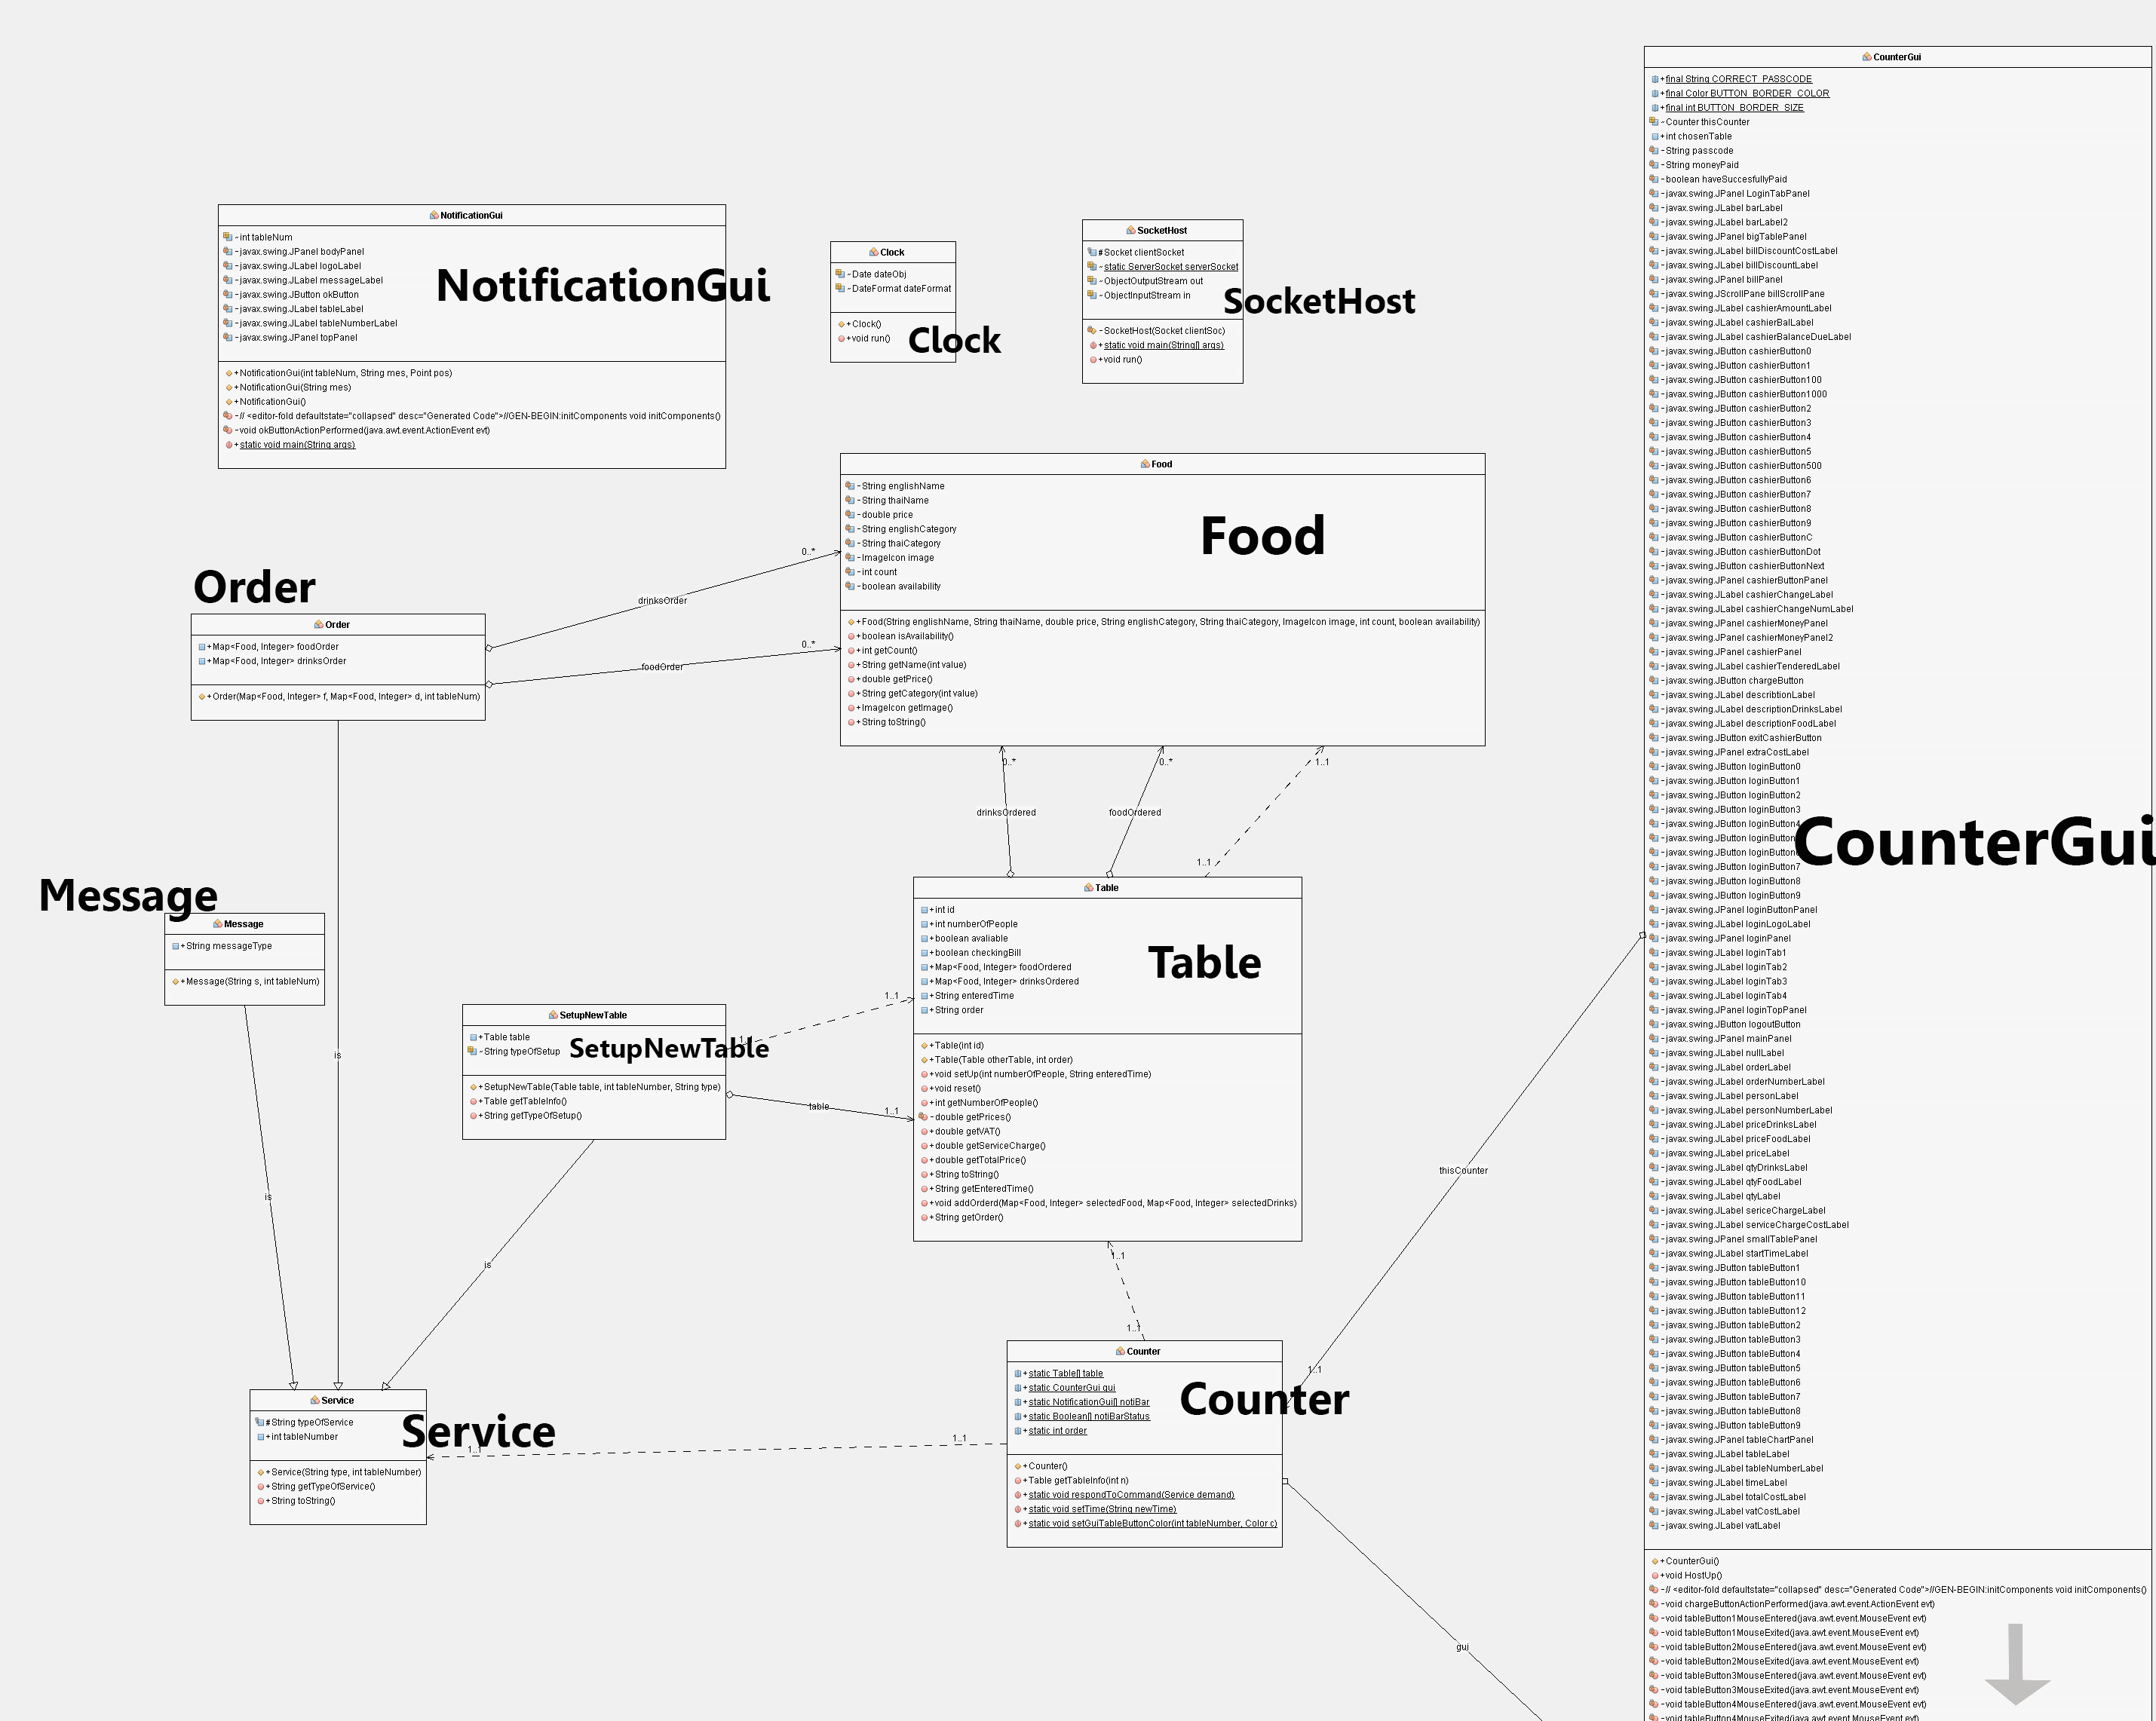
Counter Diagram

Slide 34
Thank you
for your attention

